Slide 1
Memory Allocation Functions
C gives us two choices when we want to reserve memory locations for an object:
static allocation and dynamic allocation.
Memory Usage
Static Memory Allocation
Dynamic Memory Allocation
Memory Allocation Functions
Releasing Memory (free)

Slide 2
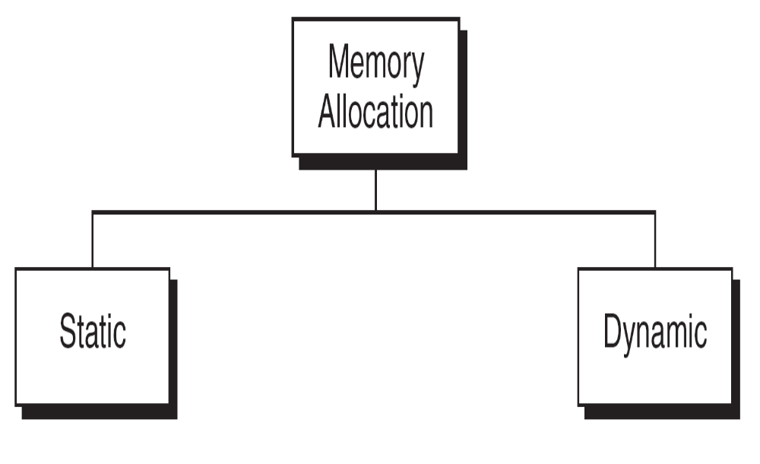
Memory Allocation

Slide 3
Conceptually memory is divided into program memory and data
memory.
Program memory consists of the memory used for main and all called functions.
Data memory consists of permanent definitions, such as global data and constants, local declarations, and dynamic data memory.
All functions, local and global data can be stored in stack memory.
Heap memory is unused memory allocation known as the heap is available to be assigned during its execution.
It is the memory pool from which memory is allocated when requested by the memory allocation functions.

Slide 4
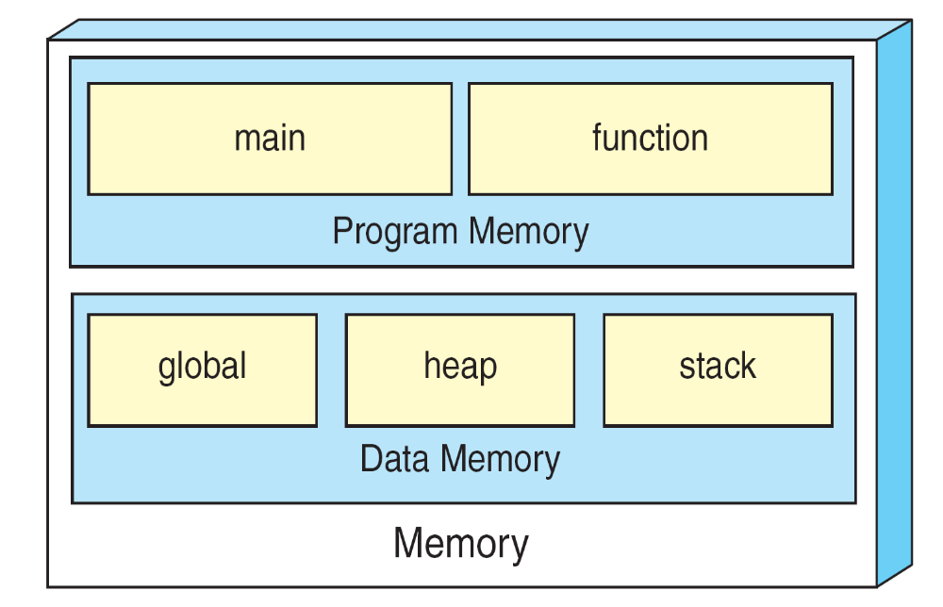
We can refer to memory allocated in the heap only
through a pointer.
A Conceptual View of Memory

Slide 5
Static Memory Allocation requires that the declaration and definition of memory be fully specified in the source program.
The number bytes reserved can not be changed during run time.
Dynamic Memory Allocation uses predefined functions to allocate and release memory for data while the program is running.
Unlike static memory allocation, dynamic memory allocation has no identifier associated with it; it has only an address that must be used to access it.
To access data in dynamic memory therefore, we must use a pointer.

Slide 6
Accessing Dynamic Memory

Slide 7
Memory Allocation Functions:
Four memory management functions are used with dynamic memory.
Three of them, malloc, calloc, and realloc, are used for memory allocation.
The fourth, is used to return memory when it is no longer needed.
All the memory management functions are found in the standard library file stdlib.h

Slide 8
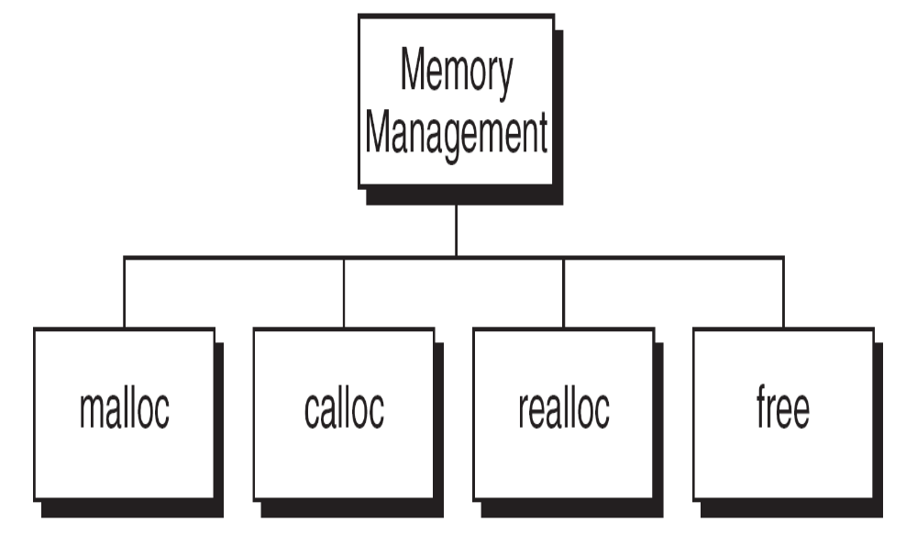
Memory Management Functions

Slide 9
Block Memory Allocation ( malloc )
The malloc function allocates a block of memory that contains the number of bytes specified in its parameter.
It returns a pointer of type void to the first byte of the allocated memory, even the allocated memory is not initialized.
The malloc function declaration is shown below:
void* malloc (size_t size);
The type, size_t, is defined in several header files including stdio.h
The type is usually an unsigned integer.
The size specification in malloc’s actual parameter is generally computed using the sizeof operator.

Slide 10
Block Memory Allocation ( malloc ) Contd…
For example, if we want to allocate an integer in the heap, we code the call as shown below:
pInt = malloc(sizeof(int));
If successful, malloc returns the address of the first byte in the memory space allocated.
However, if it is not successful, malloc returns NULL pointer.
Never call malloc with a zero size, result is unpredictable.
Memory allocation casting:
pointer_name = (type*) malloc(size);
An attempt to allocate memory from the heap when memory is insufficient is known as overflow.

Slide 11
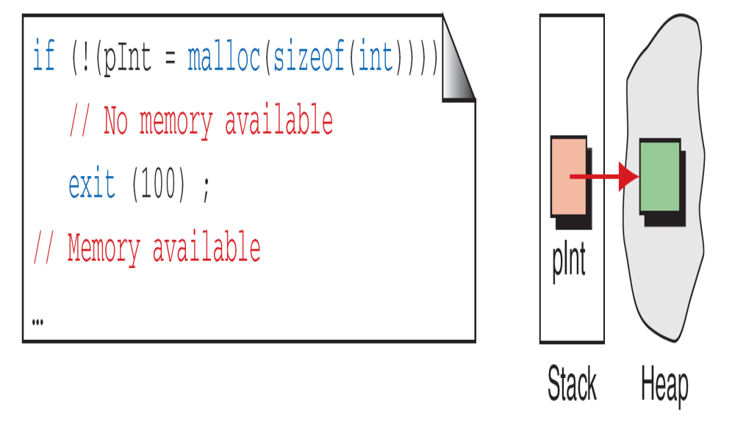
malloc

Slide 12
Continuous Memory Allocation ( calloc ) Contd…
The calloc function is primarily used to allocate memory for arrays.
It differs from malloc only in that it sets memory to null characters.
The calloc function declaration is shown below.
void *calloc(size_t element-count, size_t element-size);
The result is the same for both malloc and calloc when overflow occurs and when a zero size is given.

Slide 13
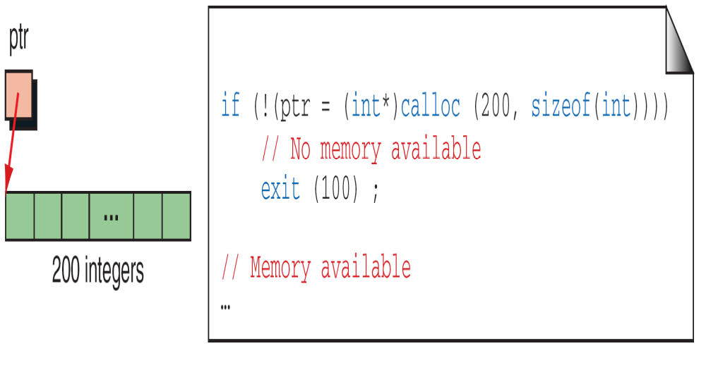
The following example creates memory for an array of 200 integers.
calloc

Slide 14
Reallocation of Memory( realloc )
The realloc function can be highly inefficient and therefore should be used advisedly.
When given a pointer to a previously allocated block of memory, realloc changes the size of the block by deleting or extending the memory at the end of the block.
If the memory can not be extended because of the other allocations, realloc allocates a completely new block, copies the existing memory allocation to the new allocation, and deletes the old allocation.
The programmer must ensure that any other pointers to the data are correctly changed.
The operation of realloc is shown below:
void *realloc (void* ptr, size_t new Size);

Slide 15
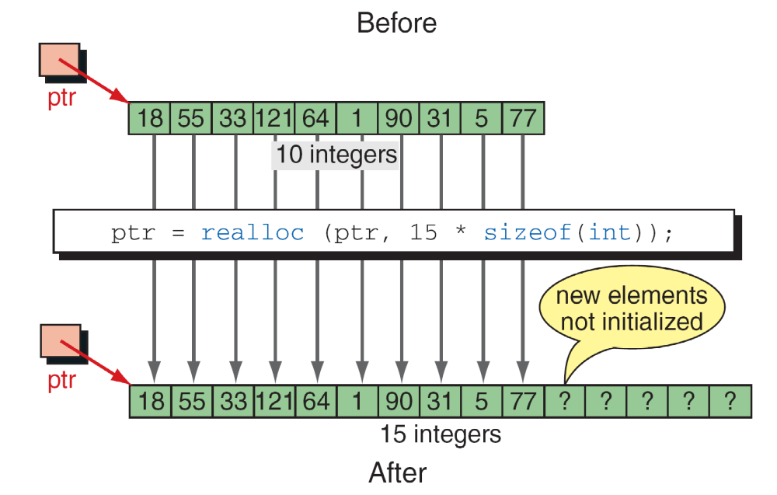
realloc

Slide 16
Releasing of memory (free)
When memory locations are allocated by malloc, calloc, or realloc are no longer needed, they should be frees using the predefined function free.
It is an error to free memory with a null pointer.
It is also a potential error to refer to memory after it has been released.
The function declaration statement fo free is shown below:
void free (void* ptr);

Slide 17
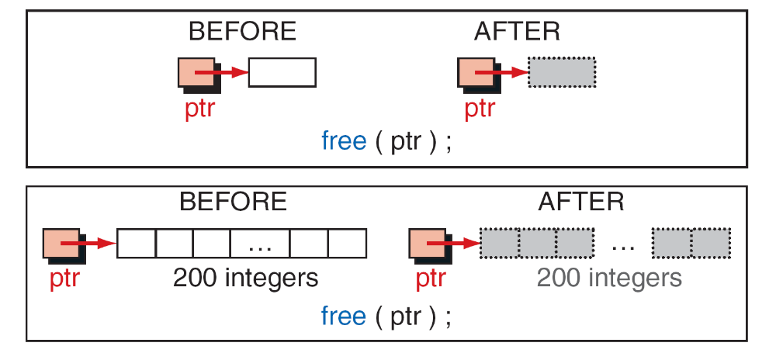
The first one releases a single element, allocated with malloc, back to heap and second one releases 200 elements (allocated with calloc) back to heap.
Note: It is not the pointers that are being released but rather what they point to.
Freeing Memory

Slide 18
Note
Using a pointer after its memory has been released is a common programming error. Guard against it
by clearing the pointer.
The pointer used to free memory must be of the same type as the pointer used to allocate the memory.

Slide 19
Array of Pointers
Another useful structure that uses arrays and pointers is an array of pointers.
This structure is especially helpful when the number of elements in the array is variable.

Slide 20
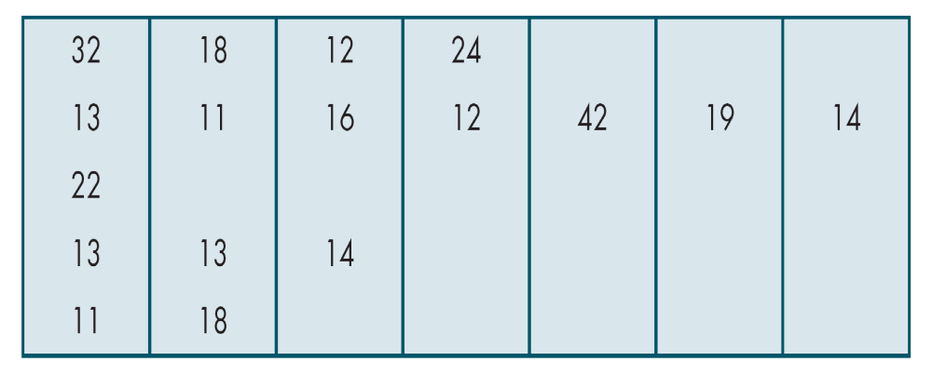
In the following two-dimensional array, only the row one is full. The rest of the rows contain from one to four elements.
This array is also known as ragged array because the right elements in each row may be empty, giving it an uneven (ragged) right border.
A Ragged Table

Slide 21
If we use a two-dimensional array for storing these numbers, we are wasting a lot of memory.
The solution in this case is to create five one-dimensional arrays that are joined through an array of pointers.

Slide 22
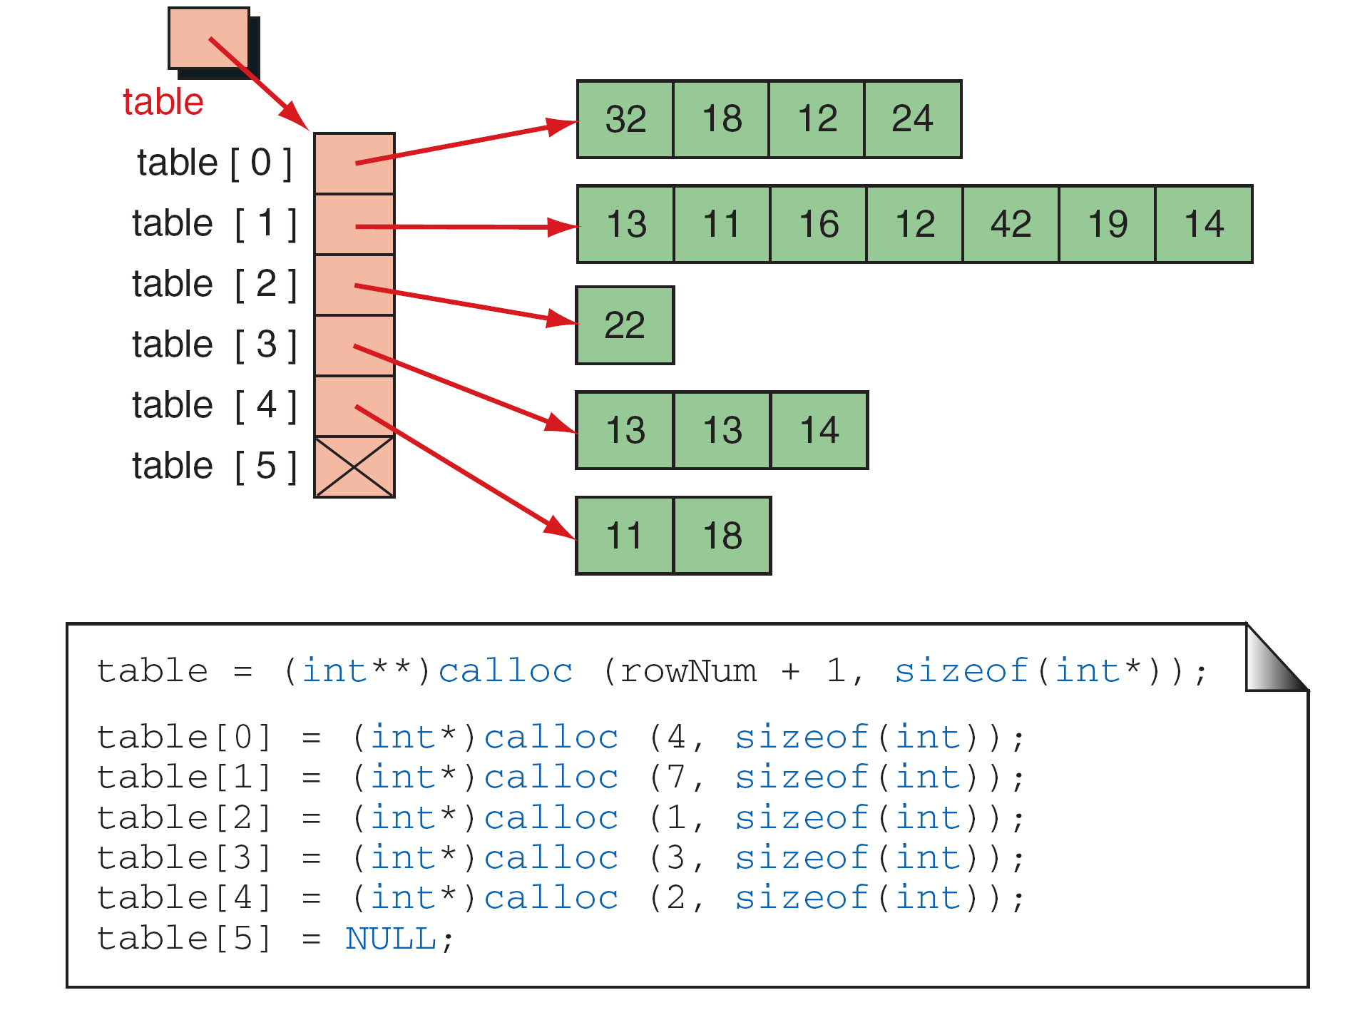
A Ragged Array

